Slide 1

Fast FoodRestaurant ManagementSystem
Fourth Semester Project :
By-Geek Freaks TECHNOLOGY
Team Member :
Amrit Pokharel
Amrit Bashyal
Santosh Neupane

Slide 2
Introduction
Welcome to the world of Fast-Food Restaurant Management System.
In this presentation, we will discuss details of our BCA 4th semester project.
Our focus: Developing a Fast-Food Restaurant Management System using VB.NET + ADO.Net [DBMS] and Windows FORMS Application

Slide 3
The Assignment Project
Our assignment revolves around creating a FastFood Restaurant Management System.
This project aims to streamline operations and enhance customer service.
Make an app that helps to record sales, supplies (inventory), and Customer Data of a FastFood restaurant like KFC, McDonald's, Starbucks, Pizza Hut.
We will utilize Windows Forms Application and Database technologies.

Slide 4
Objective of Assignment Project
Main Objective: To design an efficient restaurant management system.
Specific Goals:
- Automate order processing.
- Manage inventory seamlessly.
- Enhance customer experience.
- Generate insightful reports for decision-making.

Slide 5

Time Plan for the Work Assigned
Project Timeline:
Start Date: 2023-09-10
End Date: 2023-09-22
Key Milestones:
- Requirements Analysis
- System Development
- Testing and Debugging
- User Training
- Deployment

Slide 6
Investigation of the Problems
Identifying Challenges:
- Understanding the existing manual system
- Identifying bottlenecks in order processing
- Analyzing inventory management issues

Slide 7
System Analysis - Feasibility Study
Evaluating Project Feasibility:
- Technical Feasibility
- Economic Feasibility
- Operational Feasibility

Slide 8
System Analysis - Context Diagram
Visualizing System Components:
- User Interfaces
- Data Flow
- External Entities

Slide 9

System Analysis - Data Flow Diagram
Charting Data Movement:
- Inputs and Outputs
- Process Flows
- Data Stores

Slide 10
System Design - ER and Implementation
Designing the Entity-Relationship Model
Implementation using VB.NET and MySQL

Slide 11
System Design - User Interface
Crafting User-Friendly Interfaces:
- Order Entry
- Inventory / sales Management
- Reporting

Slide 12

Program Specification
Detailing Program Functions and Features
Listing Software Requirements
Defining User Roles and Permissions

Slide 13
Algorithms
Developing Algorithms for:
- Order Processing
- Inventory Updates
- Report Generation

Slide 14
Flowchart
Visual Representation of:
- Order Processing Logic
- Decision-Making Steps

Slide 15
Program Coding
Writing Clean and Efficient Code
Ensuring Scalability and Maintainability

Slide 16
Input Test Data
Testing the System with Sample Data
Identifying and Rectifying Issues

Slide 17

Program Testing
Software Testing:
- Unit Testing
- Integration Testing
- User Acceptance Testing

Slide 18

Output/Reports
Generating Comprehensive Reports:
Sales Reports
Inventory Reports
Financial Reports

Slide 19

Computer (Software and Hardware) Requirements
System Requirements for Running the Program
Ensuring Compatibility with Windows OS

Slide 20
User's Manual
Providing a Comprehensive User's Manual
Assisting Users in System Utilization

Slide 21
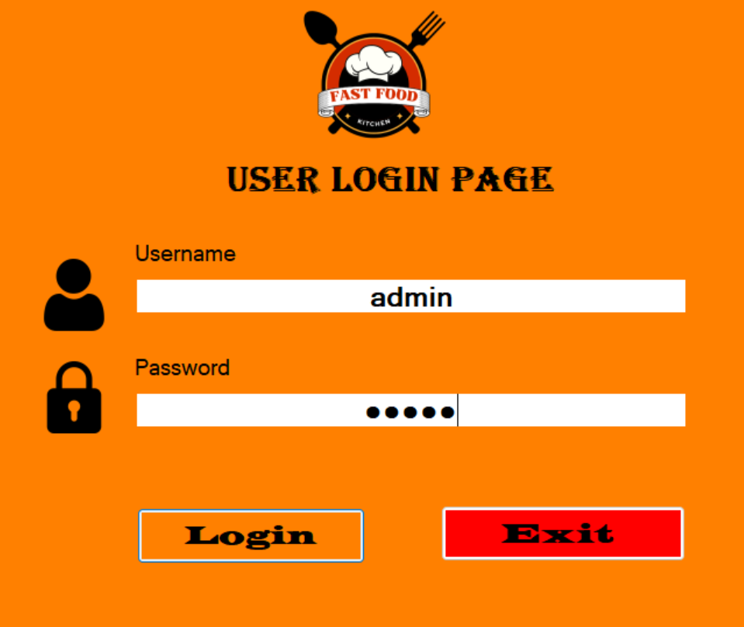
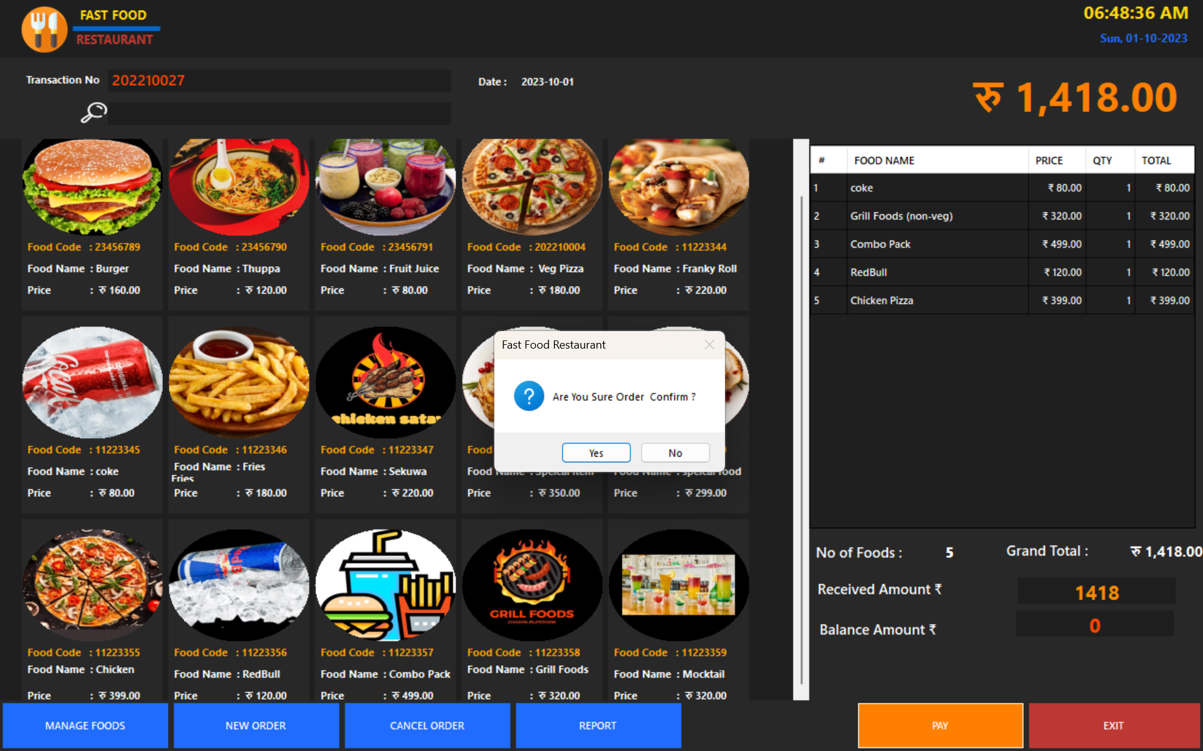
User Interfaces

Slide 22
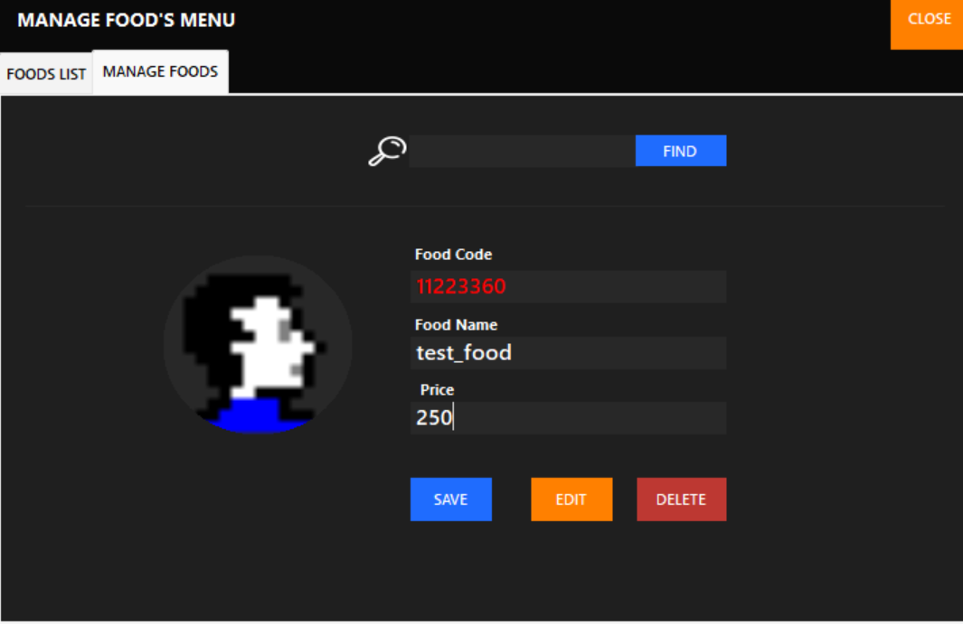
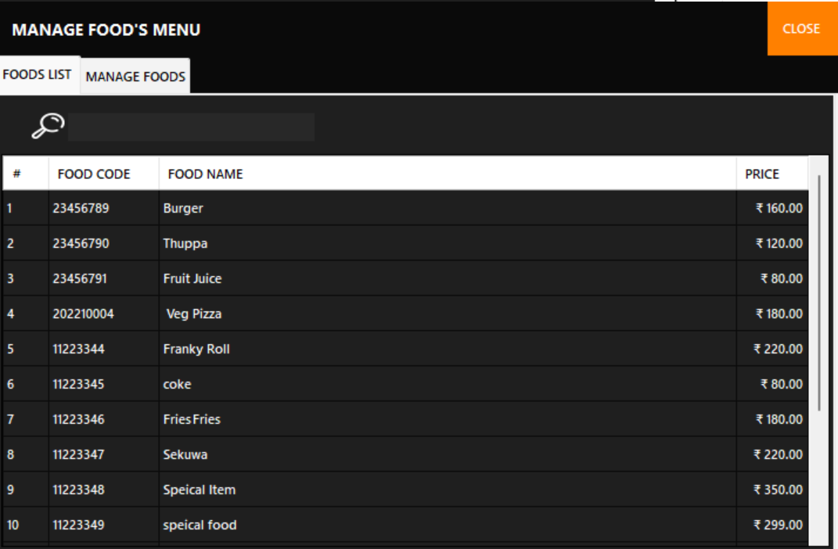

Slide 23
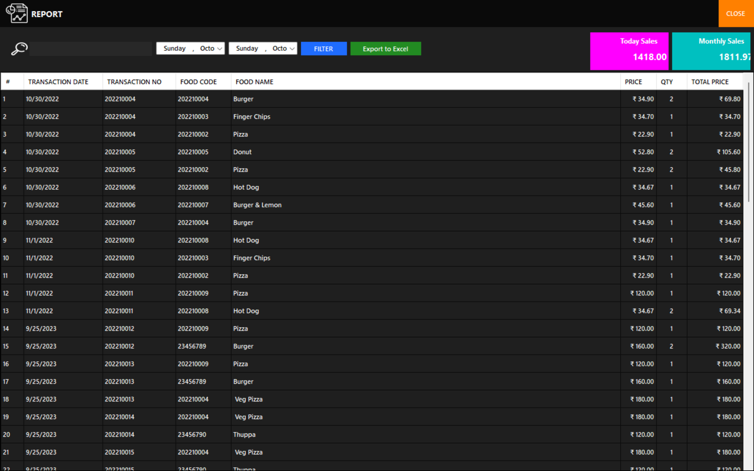

Slide 24
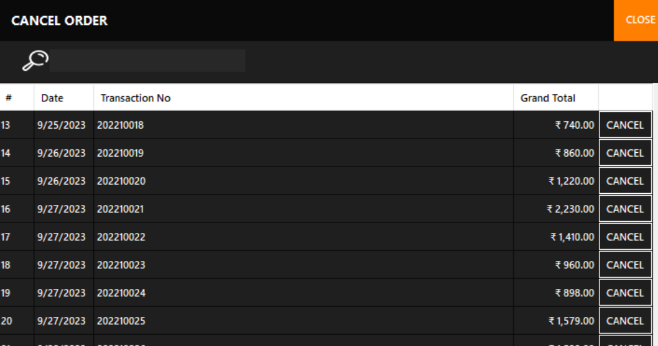

Slide 25

Software Installation and Operation Procedures
Step-by-Step Installation Guide
Detailed Instructions for Users

Slide 26

Comments on the Assignment Project
Reflecting on the Project Experience
Feedback on Teacher's Guidance and Resources

Slide 27
Conclusion and Recommendation
Summarizing
Summarizing Project Achievements
Offering
Offering Suggestions for Improvement

